Slide 1
Competitive Cyber Security Organization
General - Defensive Intro
By attending today’s meeting you acknowledge that you may be photographed or recorded for club use

Slide 2
Announcements

Slide 3
Learning Objectives:
Introduction to Defensive Cyber Security
Defensive Operational Security
Anti-virus
Rootkits & Rootkit hunting

Slide 4
What is Defense
Protecting assets and users within an environment
Asset: hardware, software, or data.
Core components:
Prevention
Detection
Response

Slide 5
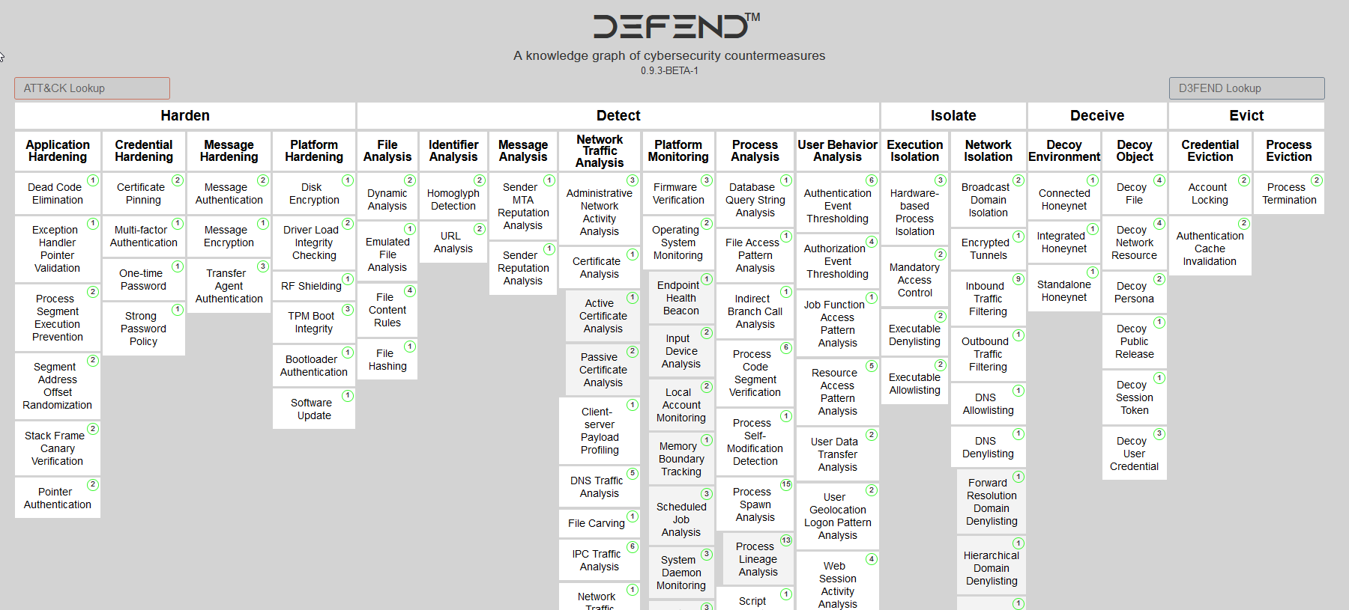

Slide 6
Important Defensive Concepts
Incident Response
(Centralized) Logging
Credz!
Networking and Firewalls
Change Mangement
And more

Slide 7
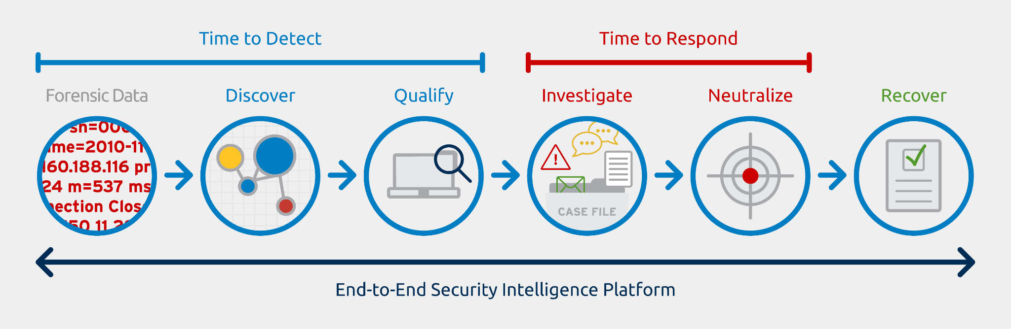
Incident Response
Analyze a past event that occurred on
Being able to identify who, what, when, where
Sources: network traffic, system logs, SIEM
What happens if logs get deleted on a server?

Slide 8


Logging
Centralized logging - collects log data from various systems and stores it in a single location.
Types of log data we can collect:
Network Traffic: Firewall, router, IDS/IPS
System Logs or Syslogs: Command history, new packages,
Service Logs: Website traffic, DB connections, Auth logs

Slide 9
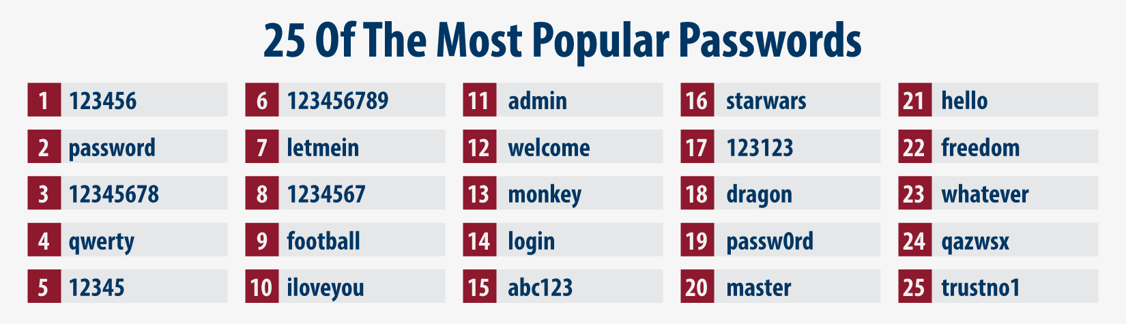
Credentials
Having secure passwords
Protecting valid credentials from attackers
Prevent brute force attacks on valid accounts
Knowing where and how they are stored

Slide 10
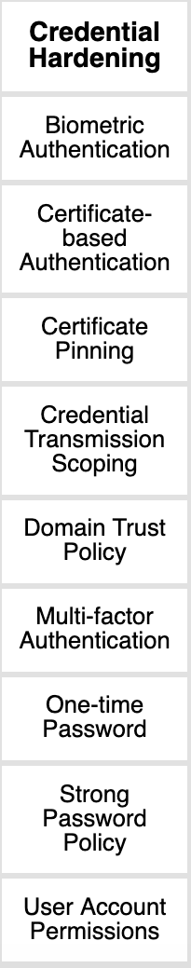
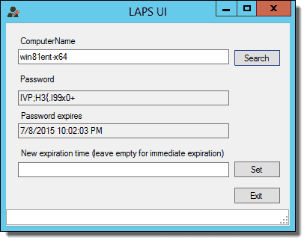
Creds cont.
LAPS
Password rotation when users leave
Privileged accounts
Least Privilege

Slide 11
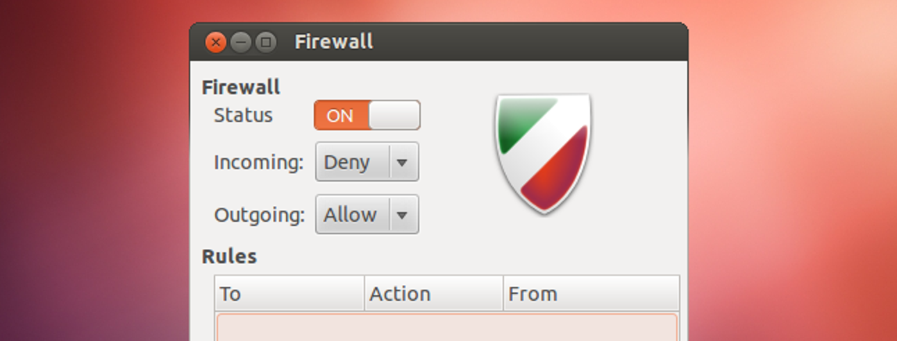
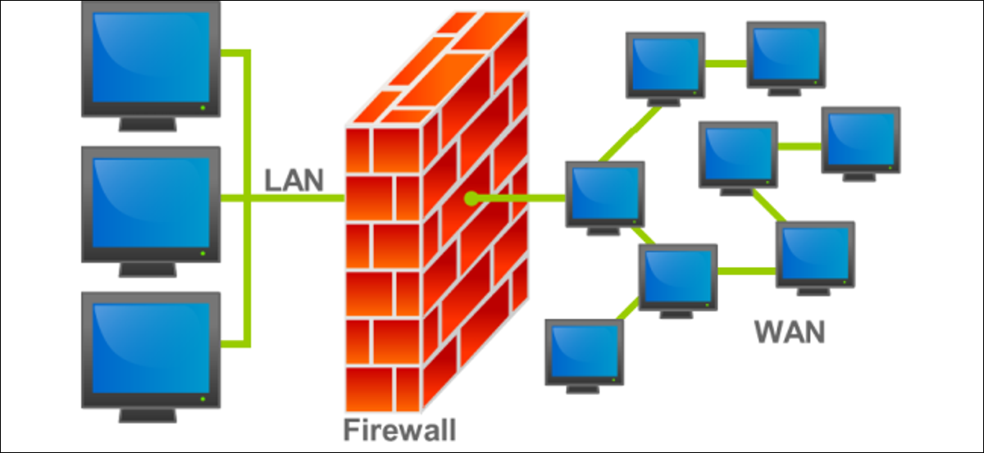
Networking / Firewalls
Host vs Network
Remove and block what is not needed / used
Telnet
Proper implementation

Slide 12
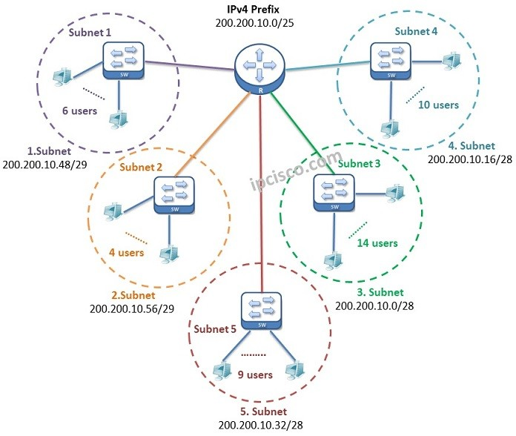
Network Design
Segmentation!!!
Separate out secure resources
LAN/Wifi/VPN/ DMZ/Mgmt/Infra
Use Firewall to create rules on which subnets can communicate

Slide 13
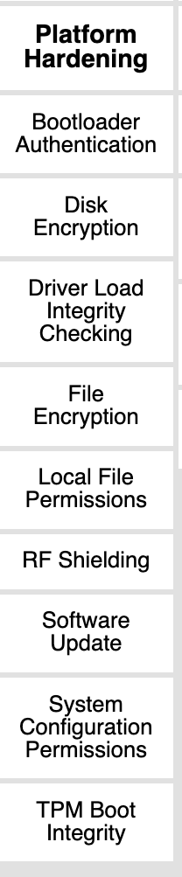
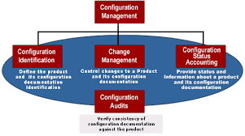
Configuration Management
Central bank of configurations
Needed for compliance
Kept safe and up to date
Track changes

Slide 14


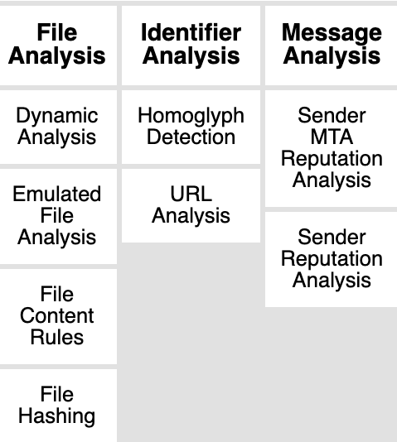
Antivirus
Prevents known malicious software from running
This is done using:
File signatures (Hashes) or names
Known activity or specific actions
Connections to known malicious hosts
Process monitoring

Slide 15
Virus Vs Rootkit
Malicious software designed to hide its existence from the system
Runs closer to the level of the system or replaces system functions to disguise itself
Uses Syscalls to directly interact with memory
Usually used by APTs Vs less advanced adversaries
https://github.com/milabs/awesome-linux-rootkits

Slide 16
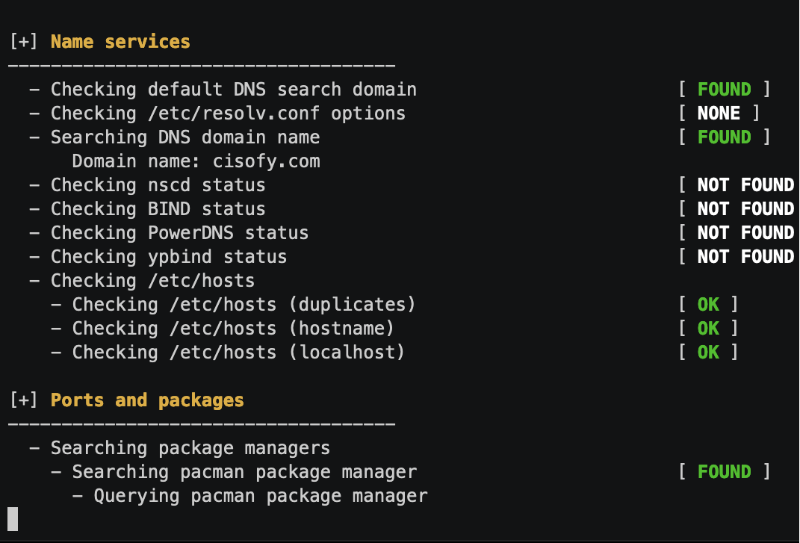
Tools to find rootkits
RKHUNTER (SourceForge)
Lynis (Github)

Slide 17

Resources
Twitter: @SwiftOnSecurity
Github: mubix /howtowinccdc
Discord Resources Channel
Google Drive (TBD to make available)
https://blueteamlabs.online/
https://tryhackme.com/dashboard

Slide 18
Design Activity:
Inventory & Users:
2 Dell Servers with ESX Virtualization
2 Public facing web servers w/ DB
3 internal web servers (Tickets, Git…)
1 DB Server
2 AD Servers & 1 Windows IIS
1 File Share & 1 Backup Server
30 VPN Users, 15 LAN Users, Guest Wifi
5 Kiosk stations for public use
1 Screen sharing device (Solstice)
Divide into teams and design a network with at least 3 subnets
List what traffic would be expected on each subnet
Place the following inventory in subnets
Users should be able to access anything underlined

